Slide 1


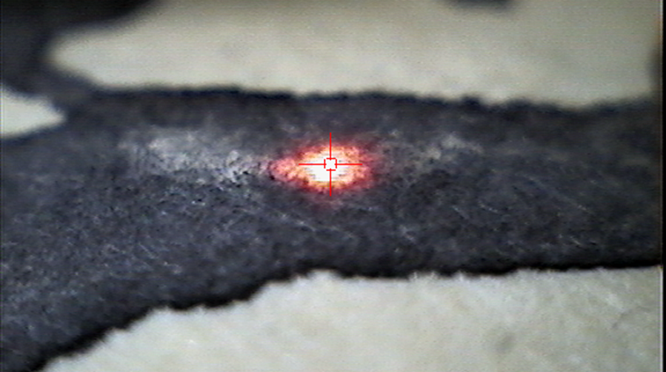
Insular Ink?
Some Initial Thoughts on Integrating Ink Analysis into the Study of Insular Manuscripts
This presentation has had elements removed from the original for copyright purposes – please don’t share the remaining text/images without contacting me first ☺
Nicole Volmering
IKGF, Friedrich-Alexander Universität, Erlangen
Insular Manuscripts AD 650-850 Workshop III Vienna, 14.06.2019

Slide 2
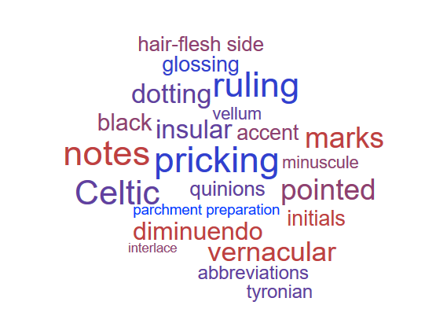
Why should we look to integrate scientific methods of ink analysis into the study of Insular manuscripts?
What is “insular”?
Insularity as a cultural typology:
“the complex network of features contributing to the cultural identity of the type”

Slide 3
When is a manuscript “insular”?: Mobility, Ethnicity, Nationality
Richard Gameson (2017) on Northumbrian manuscripts:
“because of a lack of evidence, few of the small number of manuscripts that happen to have survived can be linked to a particular scriptorium. Their script and ornament suggest that they are Northumbrian, but than that we cannot say. And even some of the volumes that look Northumbrian may not actually have been made in the kingdom—very similar styles of writing and decoration were practised elsewhere, not least in Anglo-Saxon missionary foundations on the Continent.”
Julian Brown (1978-9):
“Where the line should be drawn between ‘pure Irish script’ and ‘Irish script as developed in Northumbria’ is a difficult question: a book decorated in Northumbria in a definably Anglo-Saxon way may still be in script which is essentially Irish, even if the scribe himself was the Anglo-Saxon pupil of an Irish master. ”
“Unfortunately Insular symptoms offer but rarely a definite clue as to the Irish or Anglo-Saxon origin of a certain tradition”

Slide 4
What is “insular” in a material sense?
Insular membrane:
“suede-like finish that makes it hard to tell flesh from hair side” (Brown 1974?)
Vellum = calfskin parchment
“Insular black”
“Insular ink is often distinctively black and was never, I think, corrosive, unlike some of the paler ink used on the Continent from the fifth century to the eighth. There would be a link here with the very early period when carbon ink was the rule; but the history of inks is still too incomplete to allow pursuit of this line of enquiry.” (Brown 1978-9)
Aspects of writing and book construction: dotting (pigments), insular ruling and pricking (instruments, design), quinions,

Slide 5
What can ink analysis offer?
“The importance of the study of ink for dating of manuscripts and for their attribution to a certain country is very great“ (Diringer)
“If librarians could be induced to grant permission, one would like to submit the ink of our manuscripts to chemical analysis; … it could establish whether the blue ink found in the ninth-century additions to the Codex Bezae … is identical with the blue ink in the manuscripts of the Excerpts of Augustine made by Florus…; It might also tell us whether Northumbrian ink differed from Kentish, Irish from English and Insular from Continental” (Lowe)

Slide 6
What can ink analysis offer?
Ink and vellum are key to the production process of the manuscript: direct link to a specific locale in terms of the resources used during production.
Why are early insular ‘extra black’? What was the likely recipe?
Are there measurable, statistically relevant differences between the samples and if so, how can they be explained?
How much variation is there typically within a single source?
Distribution of inks and timeframe:
Where and when? Is ‘insular black’ used on the continent (i.e. does the production process travel with the scribe)?
How does the distribution of the inks in the manuscript correspond to the codicological and palaeographical evidence concerning the composition of the codex?
To be studied in conjunction with the vellum: flaking reputedly rare? (Lowe)

Slide 7
What can ink analysis offer?
Physical composition and production of the object (chemical composition)
assists in reconstructing different layers, with verifying contributions by different scribes, and with restoring partly erased layers of ink (assists with MSI).
Ink ‘fingerprinting’: comparing inks to one another and combine this technique with traditional codicological and palaeographical analysis to assist in the analysis of the compilation of manuscripts.
cannot provide a date; sequential and non-sequential use of ink
Comparative analysis of the chemical fingerprint of inks has the potential to differentiate inks from different localities.

Slide 8
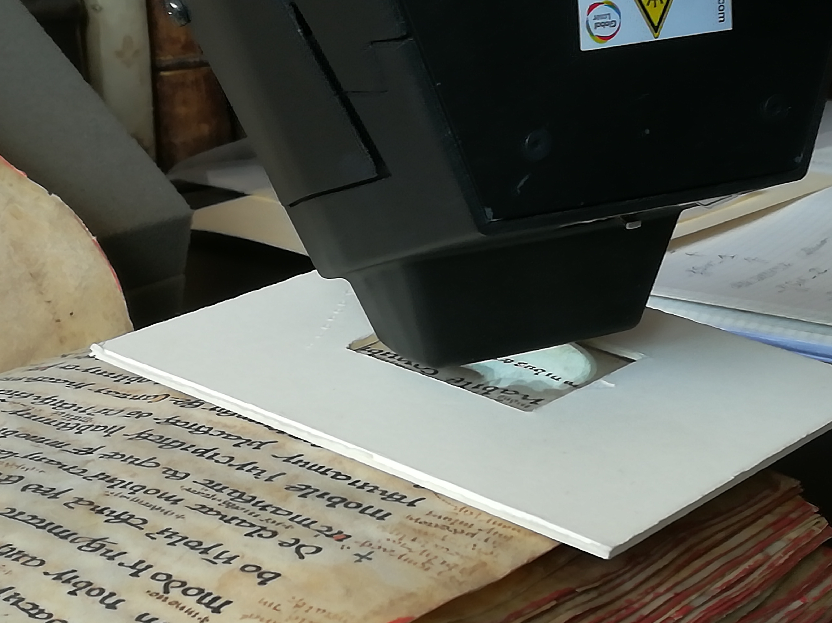
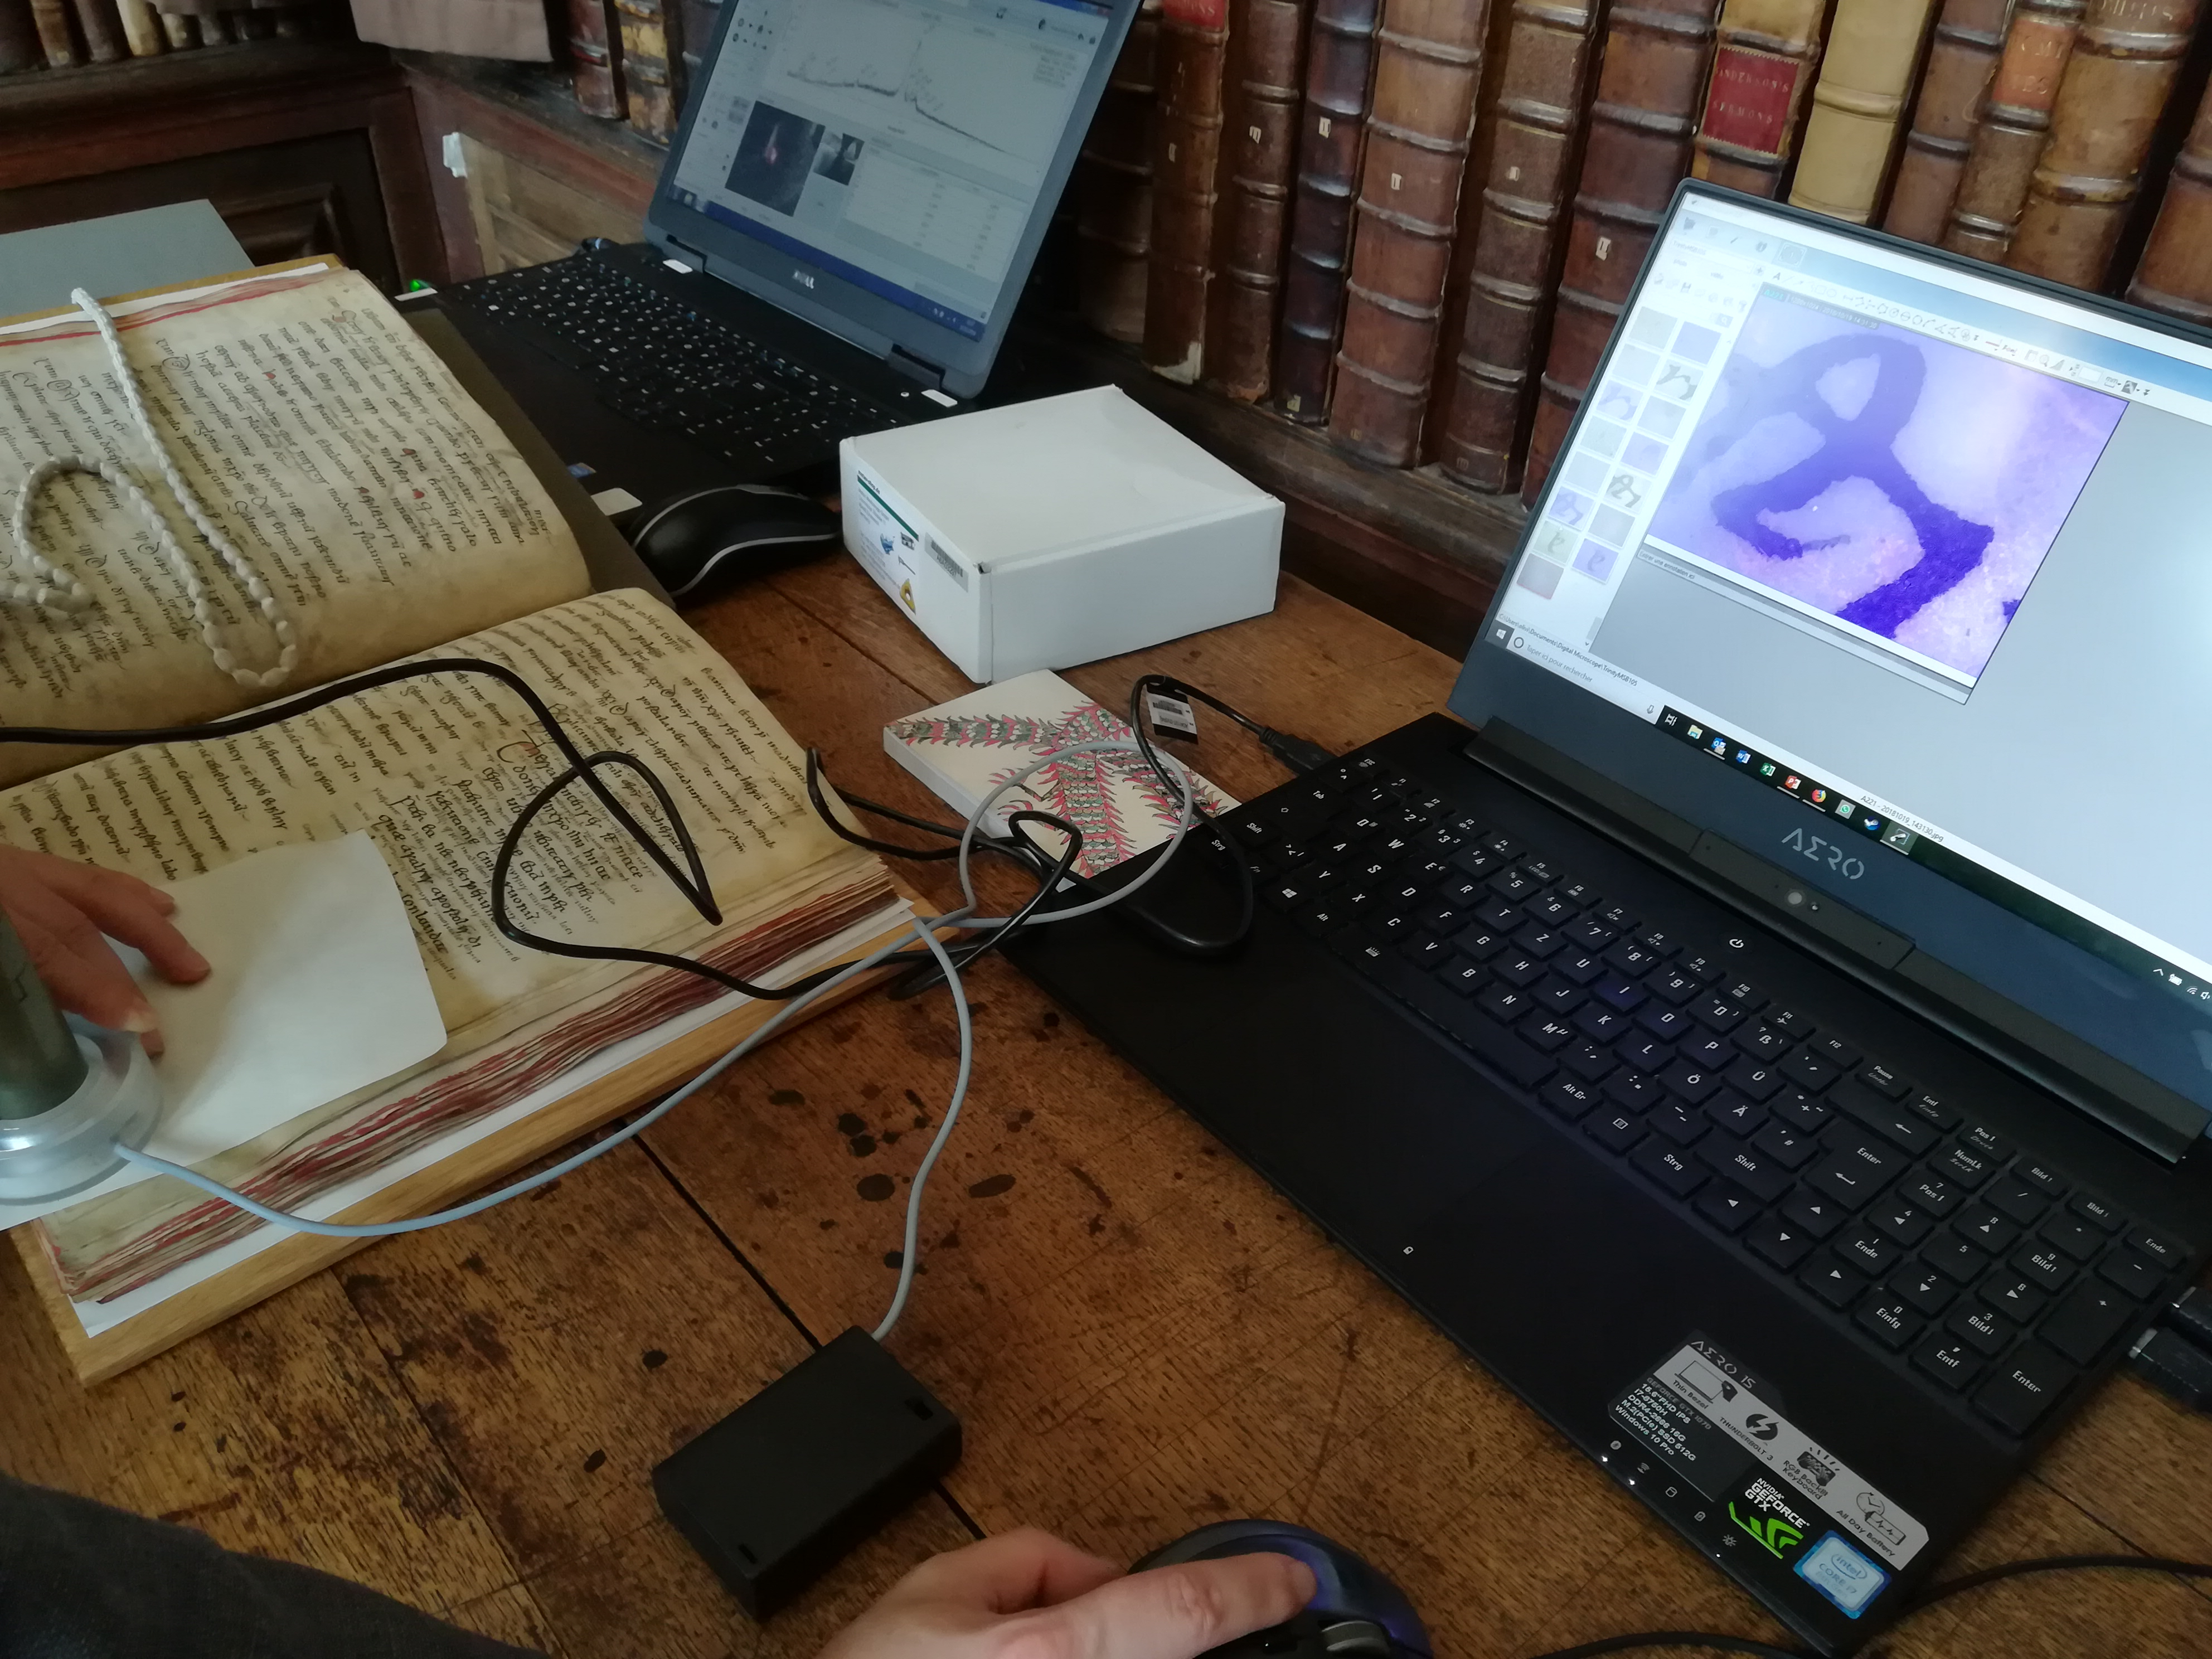
Techniques
VIS/UV/IR microscopy
X-ray fluorescence analysis (XRF)
In collaboration with the Bundesanstalt für Materialforschung und –prüfung, Berlin

Slide 9
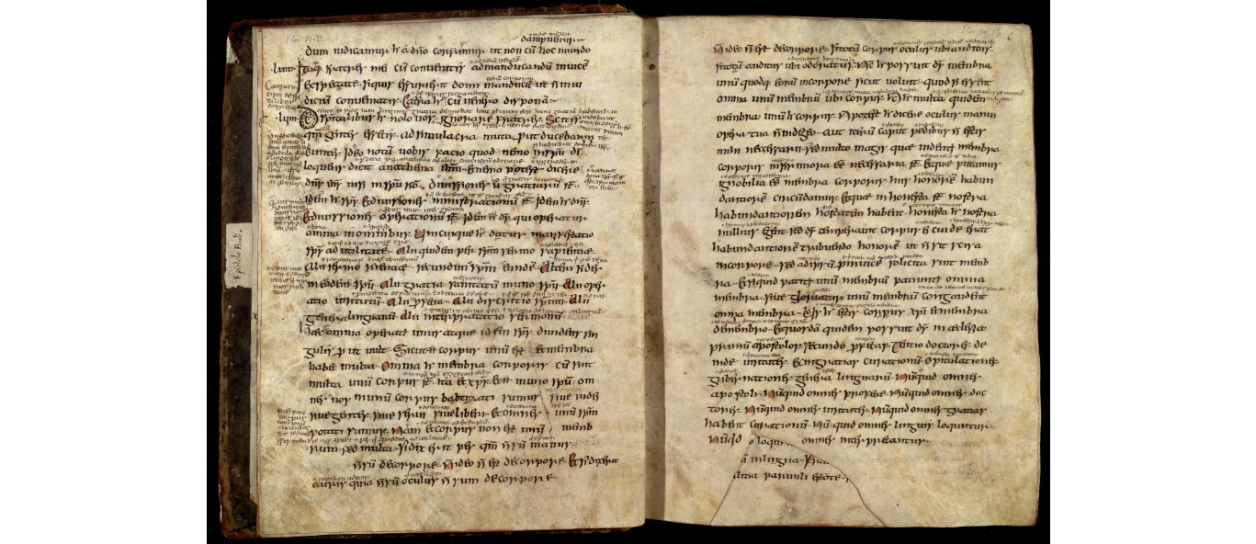
Test Case: Trinity College/Wren Library, MS B.10.5 (Pauline Epistles)*
Pauline Epistles “de manu Beda”, s. viii, 67ff, Q1-6¹⁰, Q7¹² ⁻⁴ (Four leaves of this MS. are in the Cotton MS. Vitellius C. viii.)
AS miniscule with Irish features; close to Wb Mpthf 61; and has features also in Bobbio scripts
Questions:
1. What type of ink is used in this manuscript?
2. How many different type(s) of ink can be identified?
3. What is the distribution of each ink?
4. Are the additional glosses in a
different ink?
5. Change of ink colour?
http://trin-sites-pub.trin.cam.ac.uk/james/viewpage.php?index=70
copyright the Master and Fellows of Trinity College, Cambridge
*Research carried out in collaboration with Dr Bonnerot and Dr Rabin. I also wish to thank Dr Nicolas Bell for his kind assistance.

Slide 10
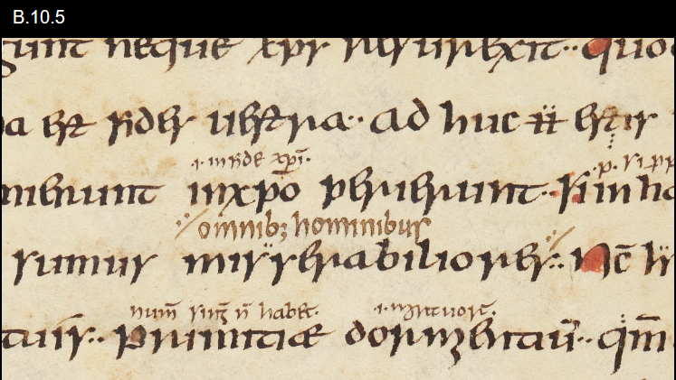
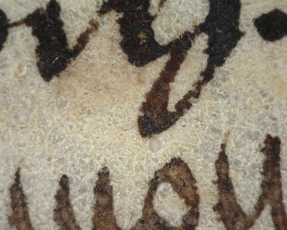
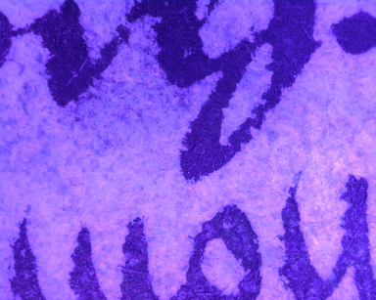
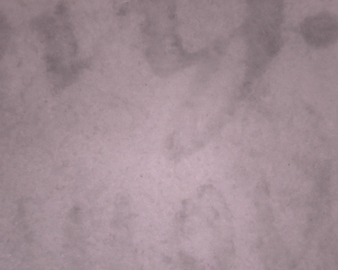
Iron Gall inks
Iron gall ink
Main & dark brown glosses: iron gall f.8v
Tag marks: plant ink

Slide 11
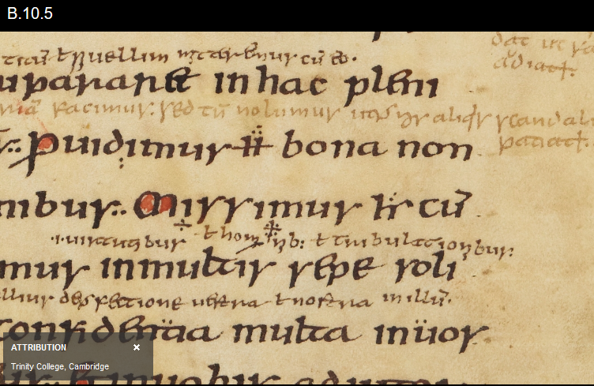
Iron Gall inks
f.15r
1 light brown
2 dark brown
3 black
Light brown gloss not in different ink from other gloss

Slide 12
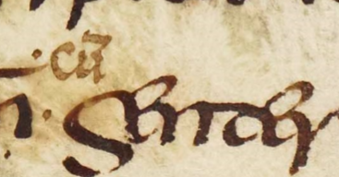
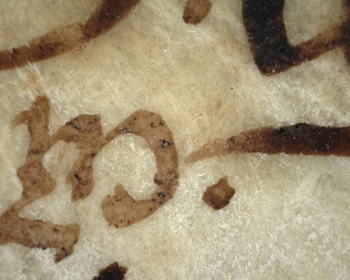
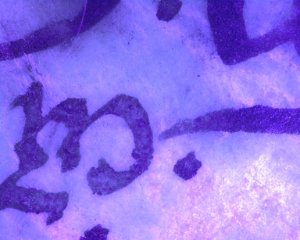
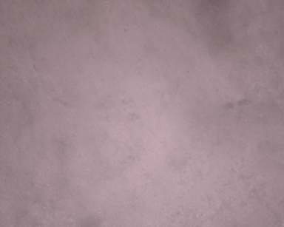
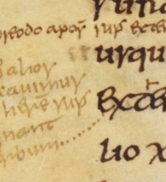
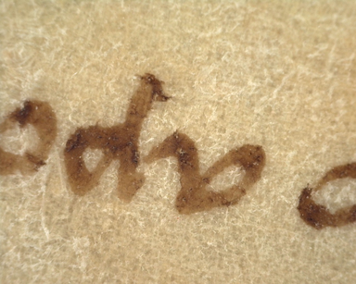
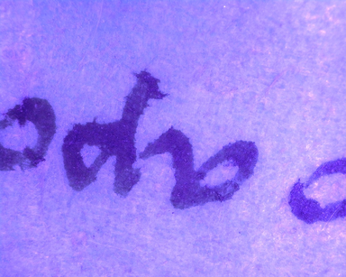
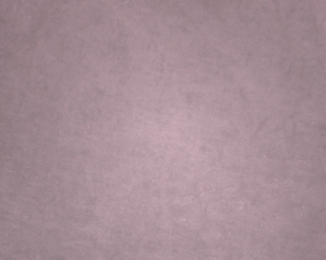
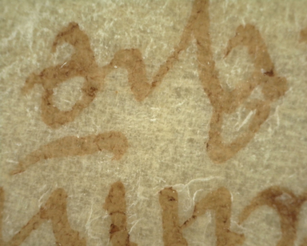
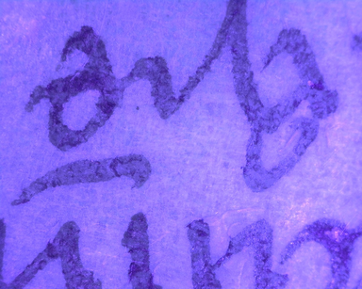
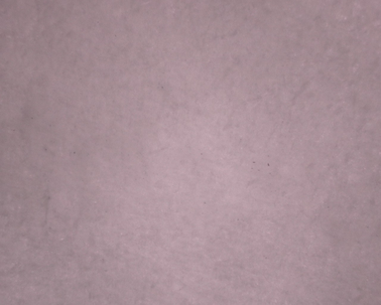
Not Iron Gall
f.3r Plant ink
f.16v Plant ink

Slide 13
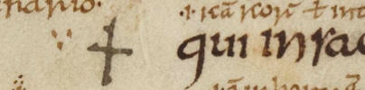
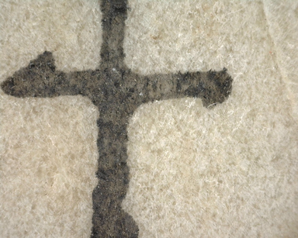
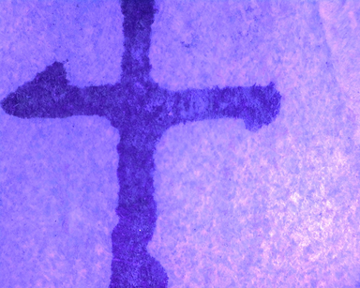
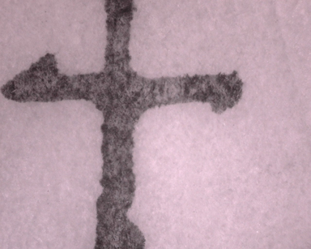
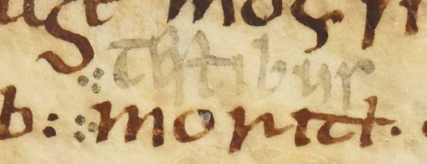
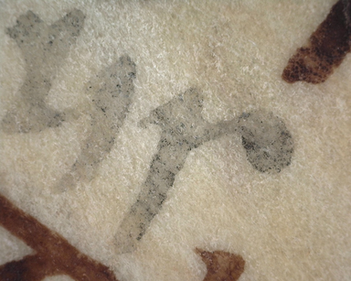
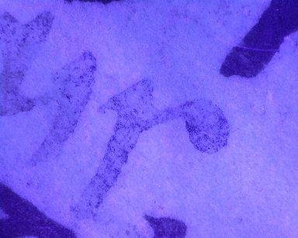
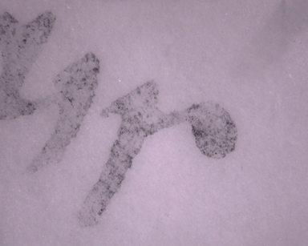
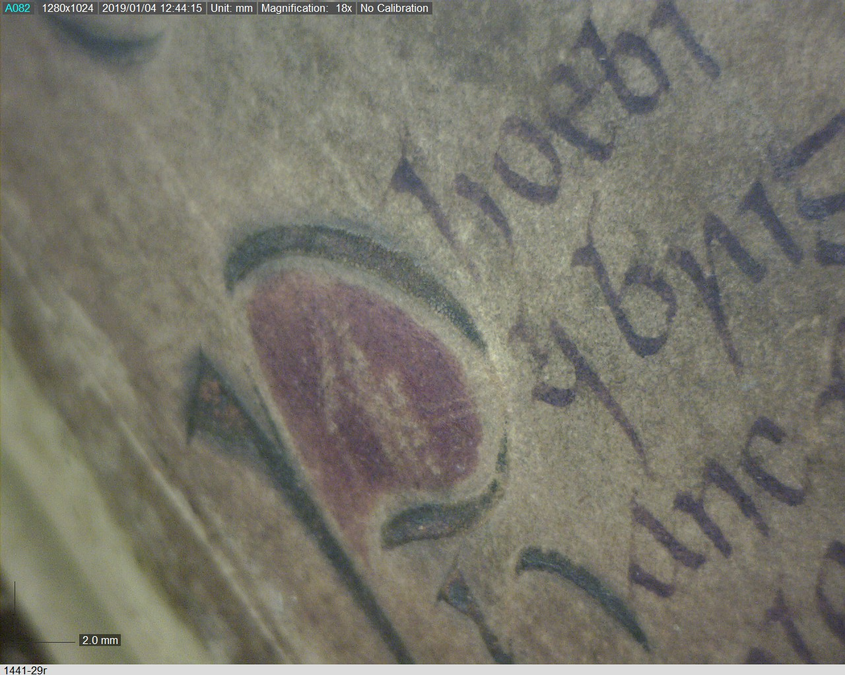
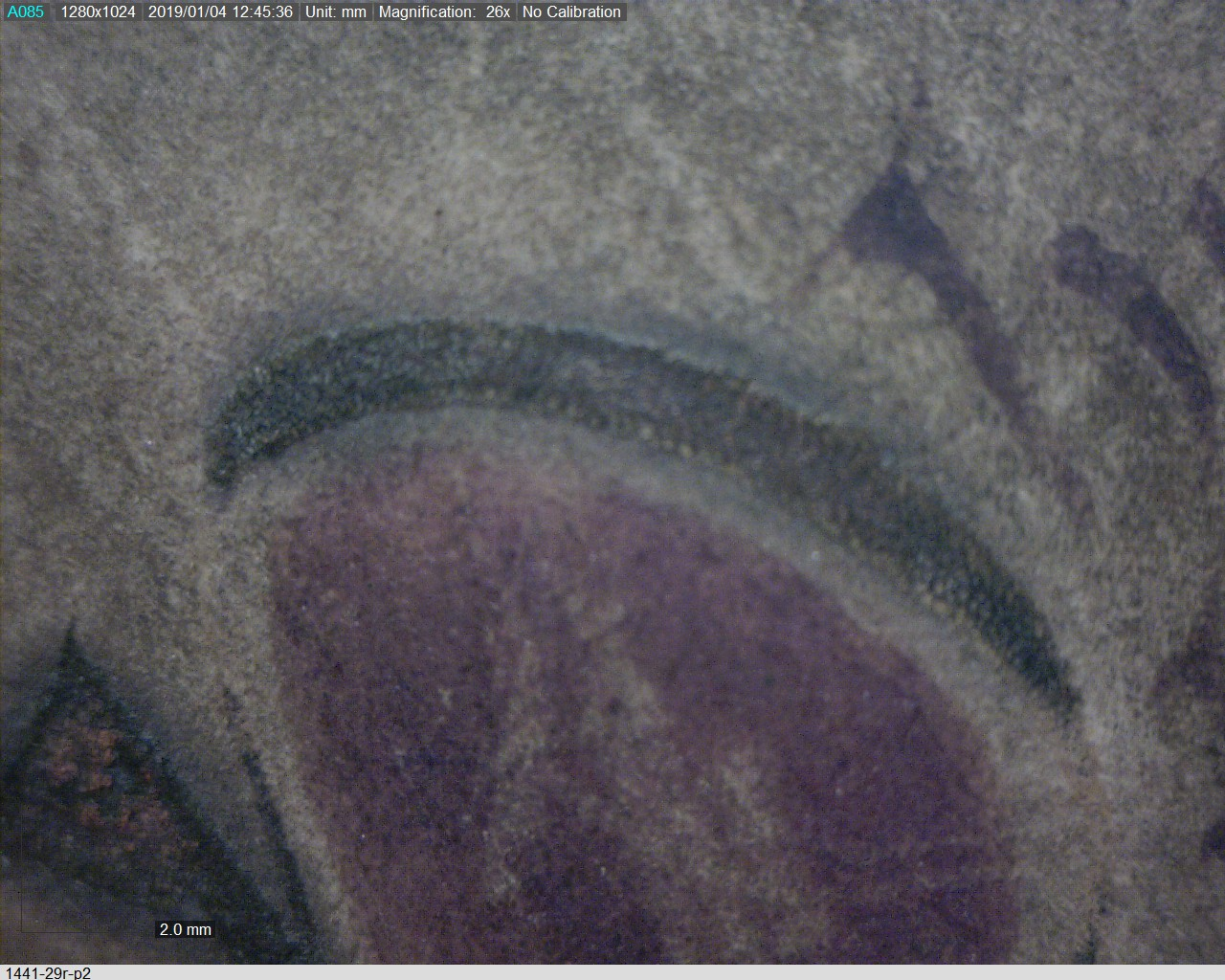
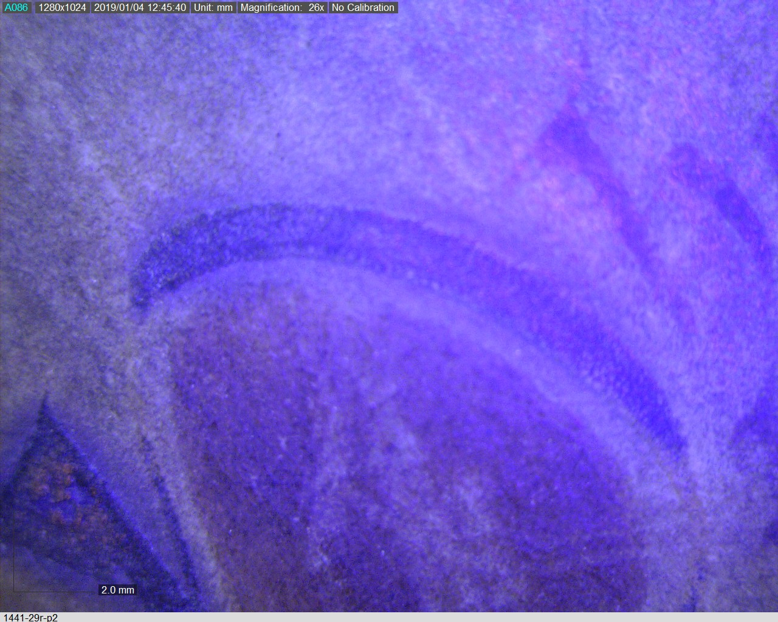
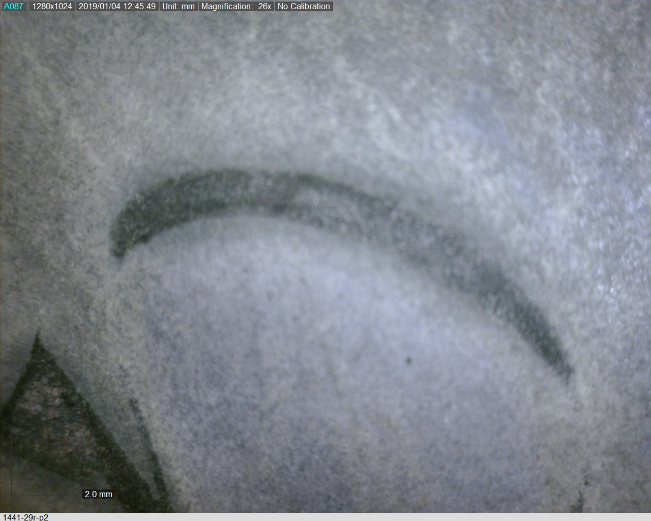
Not Iron Gall
f.3r Carbon ink
f.63v Carbon ink
Comparison:
TCD MS 1441
Liber Hymnorum
f.29r
Carbon ink initial with iron gall ink text
Image copyright: Nicole Volmering. I am grateful to the Trinity College
library staff for providing access.

